Slide 1

How to Kinect - Programmieren mit Kinect V2
Sebastian Mansow-Model
Karen Otte

Slide 2
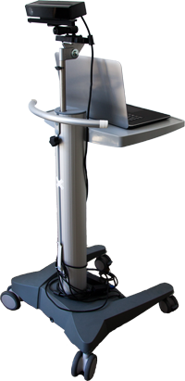
About us
Motognosis analyses the suitability of Kinect V2 in different medical studies.
Sebastian Mansow Model
Mathematician
Co-Founder of Motognosis UG
Karen Otte
Medical Computer Scientist
Software developer and Data scientist
https://github.com/KinectBerlinMeetup/Kinect101.git

Slide 3
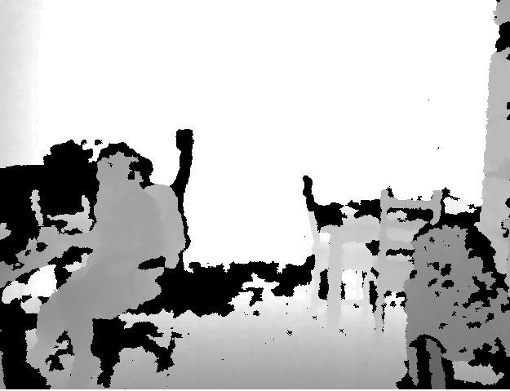
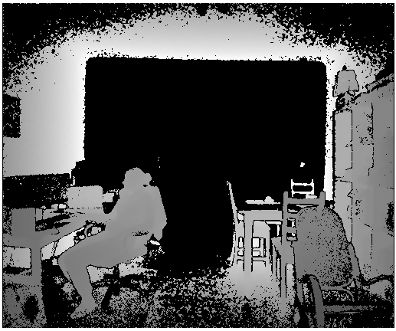
Kinect History
 | Kinect for Windows 1 | Kinect for Windows 2
Color Camera | 640 x 480 @30 fps | 1920 x 1080 @30 fps
Depth Camera | 320 x 240 | 512 x 424
Max Depth Distance | ~4.5 M | 8 M
Min Depth Distance | 40 cm in near mode | 50 cm
Depth Horizontal Field of View | 57 degrees | 70 degrees
Depth Vertical Field of View | 43 degrees | 60 degrees
Tilt Motor | yes | no
Skeleton Joints Defined | 20 joints | 25 joints
Full Skeletons Tracked | 2 | 6
USB Standard | 2.0 | 3.0

Slide 4
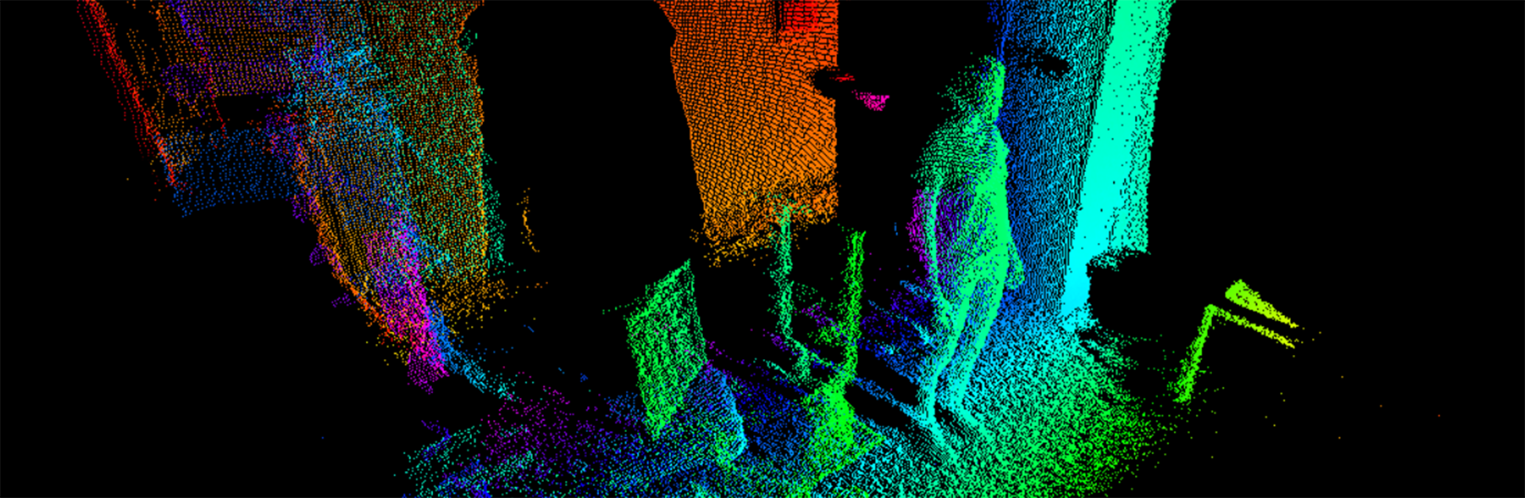
How it works – Demo Time!
Notes:
Kinect Evolution
RGB Video
Infrarot Video
Depth Video
Audio Beam
Studio
Point Cloud
Recording und wieder abspielen
HD Face Basics WPF (Gesicht zu klein gerendert???)
Kinect Fusion Explorer WPF … oder 3D Scan Store App

Slide 5
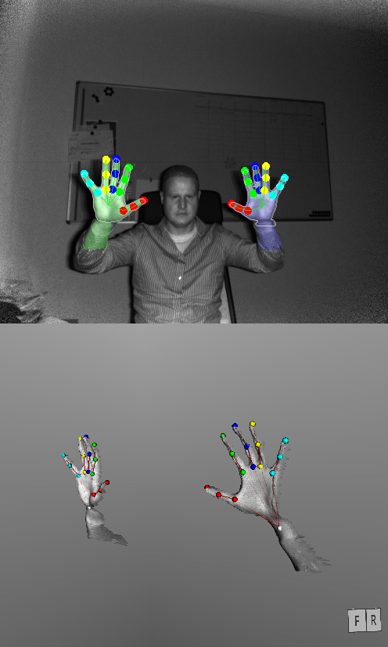
Capabilities
Im SDK:
Depth / IR
Audio
HD RGB
Face / HD Face
Skeleton
Gestures
UI Controls
3D Modell
Unity
C# / C++
Windows Store
Sonst:
Finger / Hand
Network
Multi-Kinect
Heartrate
Eyetracking
Python
JS / Node.js
Java
Processing
Linux / OS X

Slide 6
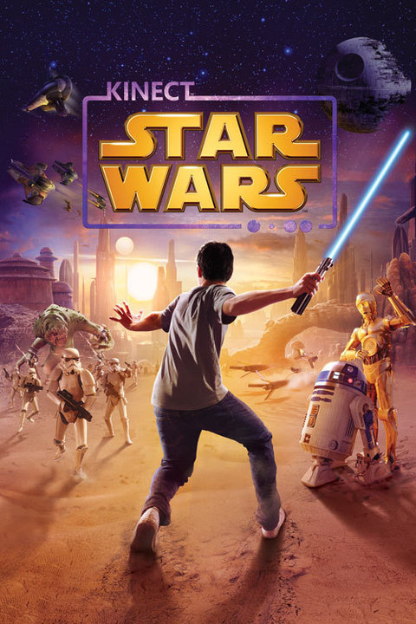
Games
V1: 130 Games
V2: 20+ Games
Themen:
Sport/Fitness/Dance
Interaction for Children
Adventures
Voice Commands (z.b. Skyrim)
As other optional Feature

Slide 7
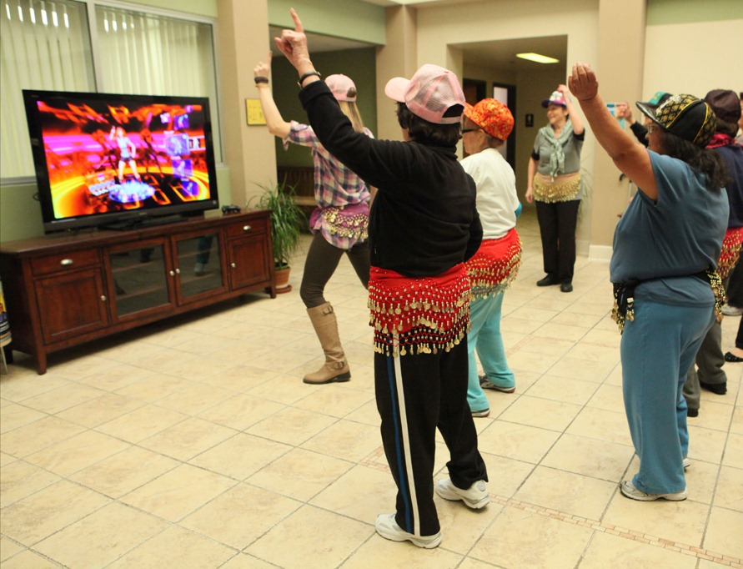
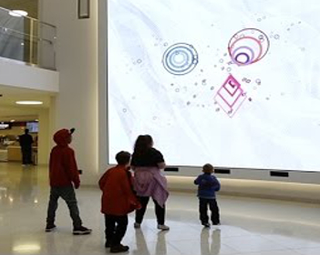
Serious Games
Physiotherapie / Reha
Cognitive Training
Elderly People
Specialised therapy for children
Education

Slide 8
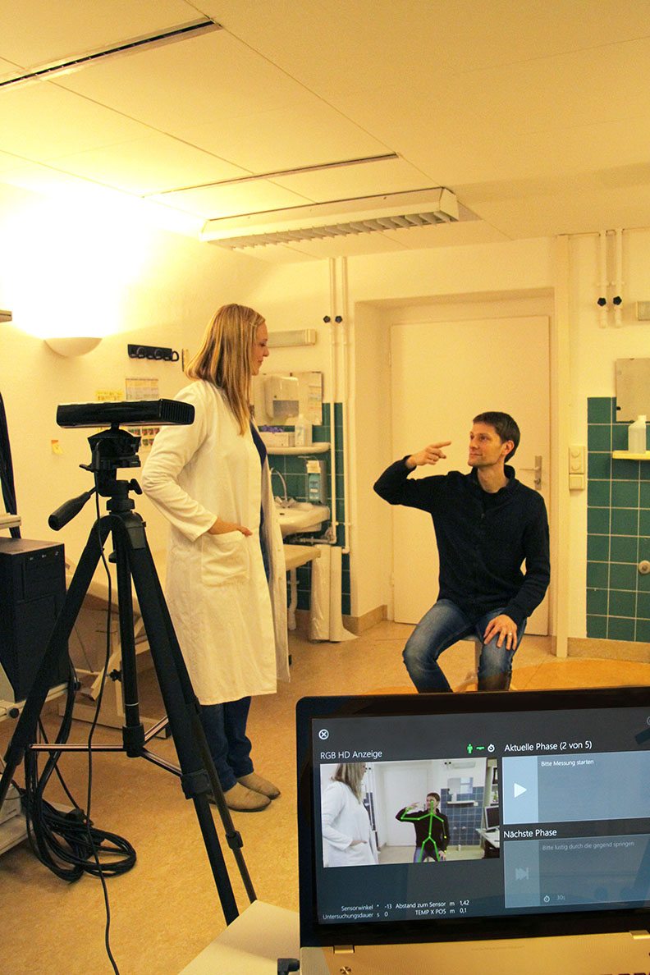
Medicine and Research
PubMed: 455+ Paper
Movement analysis
Sit, Stance, Gait
Fall detection
Sleep analysis
Breathing
Movement, Posture
Coordination
Pointing, Grabbing
Avoiding obstacles
Schoolar: 58,300 findings
Themengebiete:
robotic
3D modelling
NUI / HCI
Surveillance analysis
Motion tracking
Animal behaviour

Slide 9
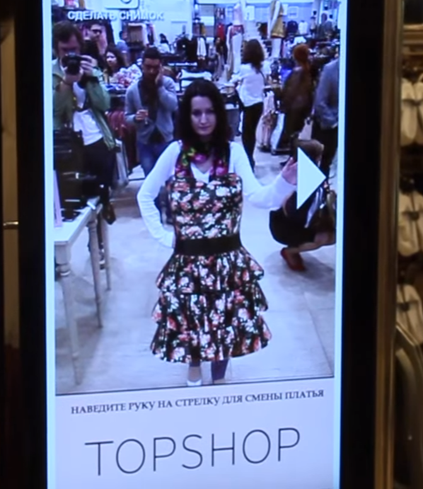
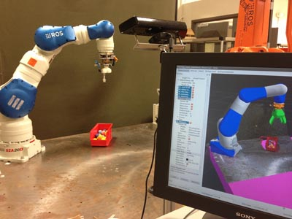
Industry and Business
Gesture control
Industrial control and safety
Motion Capture (movie and games)
Customer analysis and marketing

